Slide 1
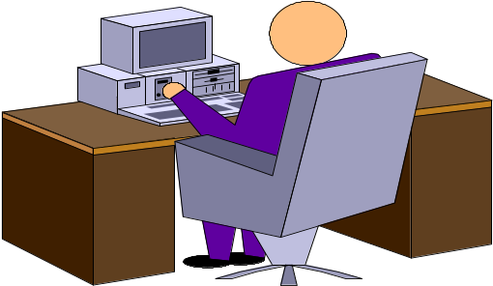
HCI – Human Computer Interaction
Syed Muhammad Shehram Shah
Lecturer
shehram.shah@faculty.muet.edu.pk

Slide 2

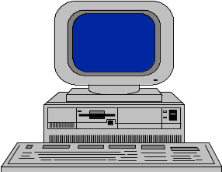
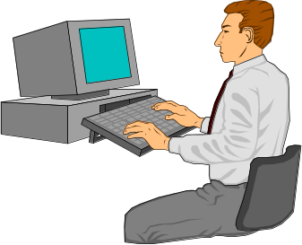

Outline
Introduction –
Human Capabilities:
Cognition and Perception

Slide 3
House Keeping
Only theory, no practical
3 Credit Hour (100 marks)
Theory: Monday, Wednesday & Friday
Sessionals:
  Test 5 Marks – Before Mid Semester
  Presentation 5 Marks – After Mid Semester
Class performance Matters

Slide 4
Recommended Reading
Human Computer Interaction
Second Edition Dix, Finlay, Abowd & Beale
User Interface Design and Evaluation Amazon
by Debbie Stone, Caroline Jarret, Mark Wooroffe
and Shailey Minocha
Design Interfaces: Patterns of Effective
Interaction Design by Jennifer Tidwell
Internet

Slide 5
Definition
What it is?
Human – Computer interaction (HCI) researches the design and use of computer technology, focusing particularly on the interfaces between people (users) and computers.
Why its done?
Researchers in the field of HCI both observe the ways in which humans interact with computers and design technologies that let humans interact with computers in novel ways.

Slide 6
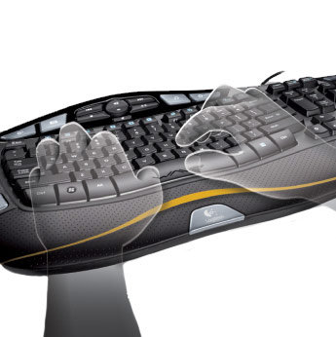
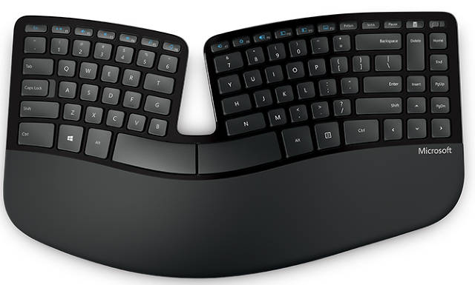
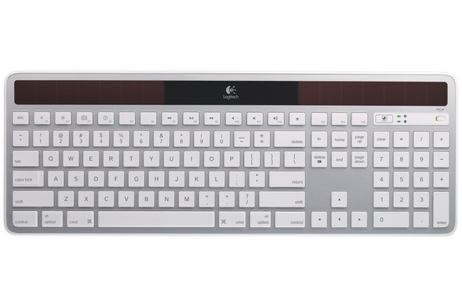
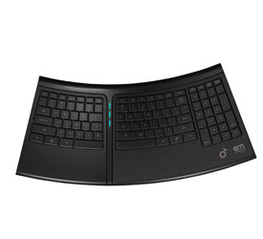
How it effects us

Slide 7
Lecture 1 Overview
Human Capabilities; People; Technology
HCI and Cognitive Frameworks
Perception
Attention / Memory
Knowledge / Conceptual Models
Learning
‘Seeing isn’t done by the eyes but the brain’

Slide 8
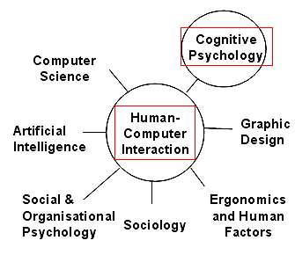
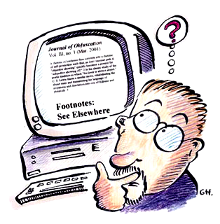
HCI and its Applications
Cognitive Computing and
its applications in HCI
Notes:
There are many applications of HCI within computing e.g.……

Slide 9
What is HCI?
CONTEXT
HUMAN
actions
MACHINE
functions
GOALS
Notes:
All machines are TOOLS operated by humans who wish to achieve certain GOALS.
The human carries out certain actions, which activate functions built in to the machine software, and hopefully these functions achieve the human’s goals. This will be done in a particular context e.g.. work environment, home computing. Context is important in HCI.
For example, if your goal is to move a piece of text from one place to another in a document, then you carry out certain actions with the mouse/pointer/menu which activate the cut & paste function of the software and this should result in you goal being fulfilled.
If the software has been ‘well designed’ (i.e.. With the user in mind) then it should be ‘easy’ for the user to learn, and remember, what functions will achieve certain goals, and what actions are needed to operate these functions.
If the actions/functions are not intuitive, or at least easily learned and retained and/or they take a long time to operate and/or they are error-prone, then we say the interface does not have good usability.

Slide 10
Central Aim and Approach of HCI
Aim: To optimise performance of human and computer together as a system
Approach: User-Centred
  Users should not have to adapt to the interface
  Interface should be intuitive/natural to learn/use.
  “Talking to users is not a luxury, it’s a necessity”

Slide 11
The Parts of
User Interface Development
Development of the user interface
Behavioural
Constructional
Development of the interaction component
COGNITION
Development of the interface software
e.g. PRINCIPLES
Human -
Computer
Notes:
The first thing to note is that, for ‘interaction’ to take place there must be at least TWO elements - in this case HUMANS and COMPUTERS. We will need some knowledge about both in order to design effective interfaces for productive interaction.
On the HUMAN side we need some knowledge about how people ‘behave’ in interactive situations. This is where cognition comes into HCI.
On the COMPUTER side, the interface designer needs knowledge of, for example, programming as well as certain ‘HCI design principles’
So, lets consider what sort of things we will need to have some knowledge about in order to design an effective interface.

Slide 12
Usability
Learnability
Efficiency
Memorability
Errors
Satisfaction
Relationship between user’s goals - required actions –results must be meaningful, not arbitrary
Therefore VISIBLE or TRANSPARENT
Notes:
Any user, when operating a machine, has certain goals in mind. A simple example, when producing a document, is that you might have the goal of wanting to make certain characters bold.
Certain actions are needed to achieve this goal; in this case, select the characters and then click the ‘bold’ icon.
The result is (usually) immediately evident - you see the characters becoming bold. [NB There are some, usually older, systems where the result is not evident until you actually print your document on paper.]
In a ‘well-designed’ interface, the relationship between these things should be ‘meaningful’. That is, it should be fairly obvious to you what actions are needed to achieve your goal, and it should be evident that your goal has been achieved.
This ‘meaningfulness of the relationship’ is sometimes referred to as VISIBILITY of the interface (sometimes called Transparency).

Slide 13
Visibility (Norman, 1988, 1992)
What does the system do, NOT how does it do it
User
Goals
Interface
Components
(controls)
User
Actions
Functions
Of the
system
Results
Feedback
Notes:
This shows the relationship in diagrammatic form. Note that a knowledge of the ‘functions’ of the system does not imply a knowledge of the inner working of the machine. That is, you need to know WHAT the system can do, but not HOW it does it.
The better the visibility, the more obvious are the actions you need to take to achieve your goal.
Feedback on the achievement of your goal is essential.
Do the controls of a car have good visibility?
What about a modern digital phone?
What about the copy function in most software systems?
Another important concept is that known as ‘AFFORDANCE’.

Slide 14
Affordance (Norman, 1988, 1992)
Normans defines affordance as
“….. A technical term that refers to the properties of objects – what sorts of operations and manipulations can be done to a particular object”
Perceived affordance – what a person thinks an object can do
  Door
  Piece of paper
  Water tap
  Button
Notes:
For example, what operations/manipulations do the following ‘afford’?
Door.
Chair.
Button.
Piece of paper.
Icon on a computer screen.
Water tap.
Perceived affordance - e.g.. water taps on Magee campus - do they afford delivery of hot water?

Slide 15
Poor interface may cause:
Increased mistakes in data entry / system operation
Inaccessible functionality
User frustration: low productivity and/or under utilisation
System failure because of user rejection
Notes:
All of these can result from a poor user interface.
For example - on inaccessible functionality - take a system with which you are very familiar, such as MSWord. Of all the functions that MSWord supplies, how many do you think you use regularly, or even over a period of a year? How many do you think you actually know about?
It has been estimated that, with much modern software, about 80% of users regularly use (or even know about) only 20% of all the possible functions.
Note the ‘user rejection’ effect above. The usability factor of user attitude is considered very important. If the people who are going to use the system regularly don’t ‘like’ it, then productivity will drop or, in extreme cases, the potential users just won’t use it at all.
One of the purposes of prototyping is to perhaps show users a number of potential designs and determine which one they ‘like best’.

Slide 16
Cognitive scientists analyse
“What the mind does…”
Investigate mechanisms/processes from which mental phenomena emerge and nature/structure of human knowledge
Mental phenomena such as……
Perceiving – learning – remembering
Controlling actions
Thinking - Emotion
Planning – Imagining – Creating
Understanding language and others
Communicating with others
Making decisions – Solving problems
Notes:
Cognitive scientists seek to analyse ….
They investigate the mechanisms and processes from which these mental phenomena emerge, and the nature and structure of human knowledge.

Slide 17
Model Human Processor
Perception (Visual)
Knowledge
Attention
Language etc
Model Human Processor
Notes:
Perception is a cognitive issue relating to the model of the human processor.

Slide 18
The Model Human Processor
Brain viewed as three interacting subsystems (each with memory store and processor)
  Perceptual system (storage of signals from senses e.g. images, sounds; brief time memory = sensory register)
  Cognitive system (‘think’, analyse, recall from LTM; storage in STM/working memory)
  Motor system (called on when physical response is required – transmit signals to muscles)
Notes:
In order to try to understand how the mind works, many psychological ‘models’ have been developed. [Note: None of these models is claimed to represent how the brain is physically constructed. In many cases it is obvious that the model is making comparisons with other physical systems such as the computer - hence their use of terms like ‘information processing’, ‘memory store’, buffer’, etc.]
One such model that has been used extensively in HCI work is referred to as the Model Human Processor. This is a quite oversimplified idea about the mind but has been successful in allowing fairly simple predictions to be made about how people will interact with a system.
In essence, it views the human mind as comprising three, interacting subsystems, each with its own memory store and processor. These subsystems are the perceptual system, the cognitive system and the motor system.

Slide 19
Perception –
Why do things look the way they do?
Perception is
  translation of physical world
  into pattern of neural activity
  that can be used by brain
  to guide behavior.
Notes:
Definition of perception

Slide 20
‘Perceptual organisation’
Understanding of how we put together the basic features
(edges, colours, motion, depth etc.)
to see a coherent organised world of things/surfaces.
Notes:
Definition of perceptual organisation.

Slide 21
Perception in Computing
Fundamental for HCI
Perceive info presented at/through interface
Theories of perception influence interface design
Present info in easily understandable/unambiguous manner i.e. user-centred
Active process
Notes:
Perception is a cognitive issue relating to HCI

Slide 22
Why Study Perception ?
Practical reasons:
  Identify/correct environmental hazards;
  Design devices
    to optimize perceptual performance;
    for people with perceptual impairments.
Perception and pleasure:
  Visual art/music/gourmet cuisine engage sensory system in ways that we find pleasurable
  Understanding perception allows us to heighten our sensory experiences.
Perception and intellectual curiosity

Slide 23
Visual Perception:
Perceptual world can be different from real world!
Human system is capable of perceiving objects
  brightest of sunlight/darkest of night
  rapidly moving objects/rapidly decaying events
Human system cannot perceive
  Bullet being shot / Plant growing / Infrared light
So we can obtain info from displays
which vary in quality, size and other characteristics
but not with uniform efficiency across whole spectrum and all speeds
Notes:
Perceptual worlds might be different from our real or human worlds.
Investigate: our near senses and far senses: seeing/hearing/listening ; smell ; touch/taste.

Slide 24
Properties of Vision
– People draw distinctions between what is seen
  “Object recognition”
  This could mean “is this a fish or a bicycle?”
  It could mean “is this George Washington?”
  It could mean “is this poisonous or not?”
  It could mean “is this slippery or not?”
  It could mean “will this support my weight?”
  Great mystery
    How to build programs that draw useful distinctions based on image properties.

Slide 25
Text Density
On paper, density of 70-80% common
  70% of page covered in text
  Readable but on computer screen would be difficult
On screen, 15-20% recommended
On its own not sufficient measure of readability
  Way text is structured also very important (e.g. search info)
  E.g. phone directory in tabular form to make easier to search
Notes:
With text on paper you will often find a density of 70% to 80%. That is, 70% of the page is covered with text. This is usually readable, but the same density on a computer screen is much more difficult. In this case, a density of 15% to 20% is recommended.
However, density alone is not a sufficient measure of readability; the way the text is structured on the screen is also very important. This is especially true when the user is required to search for information on the screen (as opposed to simply reading all the text sequentially). For example, a telephone directory is deliberately set out in tabular form to make it easier to find information. (See also the example in Preece et al, (1994) pp. 103.)

Slide 26
Text Legibility (1)
Use standard rules for UPPER and/or lower case
  Longer text passages are easier read using standard capitalization rules rather than using all capital letters
  READING ALL CAPITAL LETTERS CAN TAKE LONGER
  AS WORDS LOSE CHARACTERISTIC SHAPE -
  WORDS BECOME RECTANGULAR
Improper grammar/punctuation slows reading speed
Notes:
There are a number of things that can determine legibility of text. For example,
- Use the standard rules for lower case and capitals rather than capitals alone when you have a fairly long piece of text as this makes it easier to read.
- Improper grammar and punctuation can slow the reading speed.

Slide 27
Text Legibility (2)
Some font styles might look decorative but they are not necessarily legible
  Stick to common fonts
  Rule: don’t use >3 fonts and font sizes per document
If yu mst use abbrev mke sre th usrs r famlr wth thm
Keep text lines short
  Long line lengths can be difficult to read
Notes:
- “Funny” font styles might look decorative but they are not necessarily legible - stick to the common fonts such as Times, Geneva, Courier.
- It is a general rule that you shouldn’t use more than three fonts, and three different font sizes, in a document.
- Keep lines of text short (about 8 words per line) - this helps the reader’s eye to locate the beginning of the next line.
- If you mst use abbrev mke sre th usrs r famlr wth thm.

Slide 28
Visual and Other Coding
Differing Intensity (brightness, lightness)
Shape e.g. box frame (recognise/pickout)
Colour and/or shading
Underlining (not recommended in printed text – can slow reading)
Character size and font
Movement e.g. ‘micons’
Sound and/or synthesized speech
Notes:
Different types of Visual Coding may be used to draw a user’s attention to certain information in an interface. This refers to a number of techniques that might be used to attract attention, or to focus attention on particular elements on the screen. They include,
- Elements of differing intensity, (brightness or lightness) but of the same hue. If you are going to use differing intensities to distinguish between elements, make sure the difference is quite significant.
[Experiment with a ‘colour wheel’ to see the effect of changing hue, saturation and intensity of an object e.g. a text character.]
- People are good at recognising, or picking out, unusual shapes. So, for example, text placed within, say, a ‘cloud’ shape, or even a box, will stand out from the surroundings.
- Colour and shading can be used to good effect (more on this later).
- Underlining is not really recommended in printed text because it interferes with the descenders of letters (see the g, y, p in this sentence). This, LIKE CAPITAL LETTERS, destroys the characteristic shape of words and can slow down the reading speed. It can be used in handwriting where it is more difficult to use other methods of emphasis such as bold or Italic text.
- Blinking, reverse video and moving icons might be eye catching, but they can become very irritating after a short time. It is preferable to have some way of turning such features off, or don’t use them at all unless it is to warn of some urgent action required - an action that will correct a fault, say, and hence make the effect go away.

Slide 29
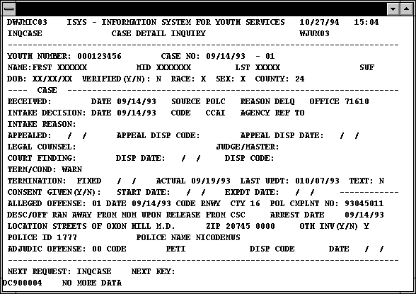
Example of Screen Design – Visualisation / Aid to Accessibility
(Source: http://www.cs.umd.edu/projects/hcil/chi96/paper/cps1txt.htm)
Notes:
This example of screen design is taken from a project at the University of Maryland,
http://www.cs.umd.edu/projects
This is the original screen design. Do you think it is a good or poor example of screen design. Justify your answer?

Slide 30
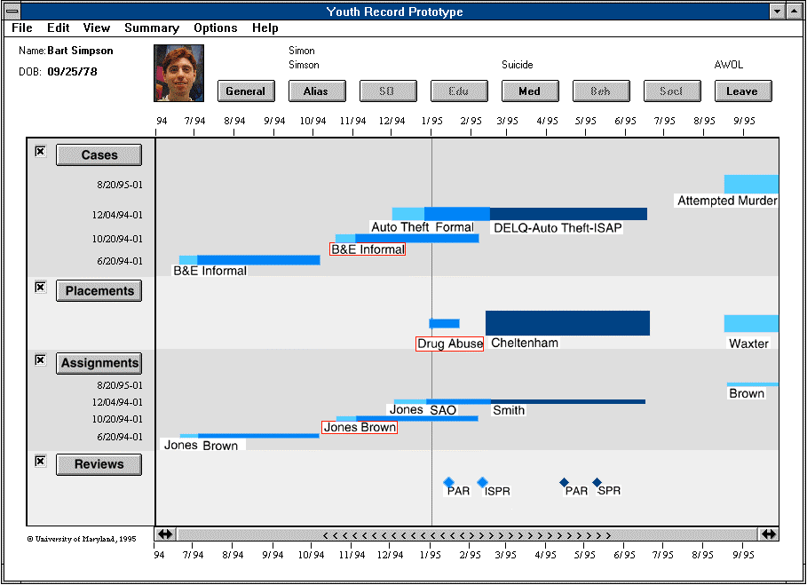
Improved Design –
What features aid readability / understanding?
(Source: http://www.cs.umd.edu/projects/)
Notes:
This is an improved screen design. What features make it easier to read and understand?

